Slide 1
Library management system
52. Amitesh Patil
54. Pranit Patil
56. Kshitij Patil
77. Vivek Pundkar

Slide 2

Introduction
Library Management System is a computerized system which helps user(librarian) to manage the library daily activity in electronic format. It reduces the risk of paper work such as file lost, file damaged and time consuming. It can help user to manage the records more effectively and timesaving. The system is developed to cope up with the current issues and problems of library .The system can add user, validate user and is also bug free. This system has two modules first one is students module and second one is admin module.

Slide 3
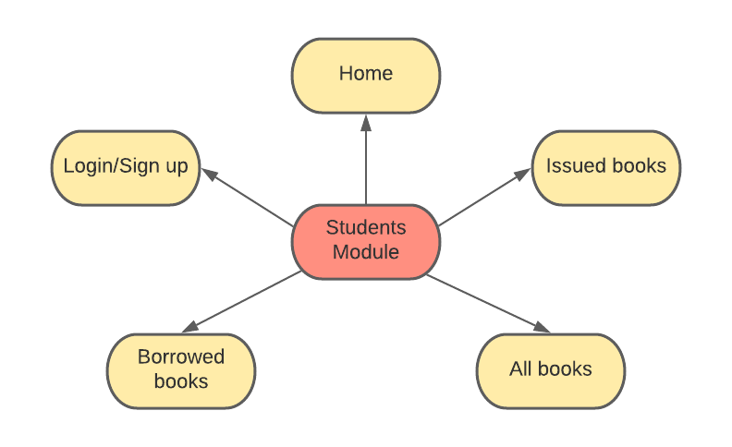
Student module

Slide 4
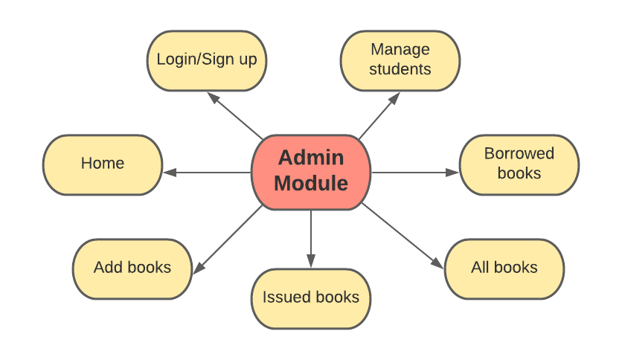
admin module

Slide 5
Tools used
Visual Studio Code
XAMPP
PHP
CPP

Slide 6
Features of students Module
Home :
Edit details : User can edit their information in this section.
All books :
List of all books will be displayed. User can also search the book according to name and ID. Details and Issue options are also available.
Currently issued books :
List of Currently Issued books will be displayed along with Issue date, Due date options and also renew and return options.
Previously borrowed books:
List of all the previously borrowed book will be displayed along with issued date and return date.

Slide 7
Features of admin Module
Home :
Edit details : Admin can edit their information in this section.
All books :
List of all books will be displayed along with, availability and edit option
Add book :
Admin can add book.
Currently issued books :
List of Issued books will be displayed along with Issue date, Due date and Dues.
Manage students :
Admin can see the details of all the students registered.

Slide 8



